Slide 1
Adaptive Pilot Placement for OFDM Channel Estimation
GRADUATE RESEARCH REVIEW
Tal Pardo · Prof. Tirza Routtenberg and Prof. Nir Shlezinger
Data subcarrier
Pilot subcarrier
Notes:
Welcome and thank you all for being here. Over the next 25 minutes I'll walk through the pilot placement problem, the model-based approach we've built, what the experiments taught us, where a prior learned CNN approach fell short, and a proposal for a deep RL agent to take this further.

Slide 2
Agenda
01
Problem formulation
02
The model-based algorithm under a known prior
03
Main takeaways from experiments
04
CNN MSE predictor
05
Proposal: a deep reinforcement-learning pilot-placement agent

Slide 3
Why pilot placement matters
SECTION 1 · PROBLEM FORMULATION
Pilots consume spectrum that could otherwise carry data — every pilot subcarrier is overhead, not payload.
Fixed, uniform pilot placement
Channel estimation accuracy depends on both how many pilots are used and where they are placed.
Same spacing every time, regardless of the channel — wasteful when correlation structure means some subcarriers reveal far more than others.
The standard baseline is fixed, uniformly-spaced pilots: simple, but blind to the actual channel.
This talk asks: can placement be adaptive — and eventually learned — to spend that overhead more efficiently?

Slide 4
System model
MIMO-OFDM channel with $N_{a}$ antennas and $N_{c}$ subcarriers, vectorized column-by-subcarrier as $h=vec\left(H\right)∈ℂ^{N} ;N=N_{a}∙N_{c}$.
One step of measurement
Each step measures one new, not-yet-piloted subcarrier k:
$$y_{t}=X_{t}h+n_{t} ; n_{t}∈𝒞𝒩\left(0,σ^{2}I\right)$$
That measurement is fed into a Bayesian (LMMSE) update, never remeasured again.
Rows = antennas
Subcarrier k, measured this step

Slide 5


Problem formulation
A sequential decision problem: which subcarrier to pilot next, repeated until a stopping rule is met.
Tx
Channel
Rx
LMMSE Channel estimator
posterior updates (ĥ, P)
Active sampling:
Choose next pilot subcarrier
No?
Error estimator
Is small enough ?
Yes?
Output final channel estimate ${\hat{h}}_{T}$

Slide 6

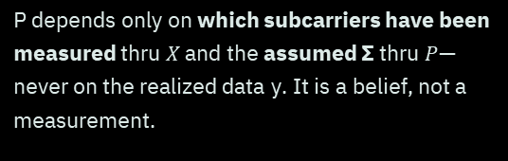
LMMSE recap
SECTION 2 · MODEL-BASED ALGORITHM
After the first measurement is taken, we initiate the channel estimate and covariance:
$$K_{t}=P_{t−1}X_{t}^{H}{\left(σ^{2}I+X_{t}P_{t−1}X_{t}^{H}\right)}^{−1}$$
A key property
$${\hat{h}}_{0}=\left(I−K_{t}X_{t}\right){\hat{h}}_{t−1}+K_{t}y_{t}$$
P depends only on which subcarriers have been measured thru $X$ and the assumed Σ thru $P$— never on the realized data y. It is a belief, not a measurement.
Every new pilot measurement updates a Bayesian posterior belief — mean and covariance — over the whole channel.
$$K_{t}=P_{t−1}X_{t}^{H}{\left(σ^{2}I+X_{t}P_{t−1}X_{t}^{H}\right)}^{−1}$$
$${\hat{h}}_{t}=\left(I−K_{t}X_{t}\right){\hat{h}}_{t−1}+K_{t}y_{t}$$
$$P_{t}=\left(I−K_{t}X_{t}\right)P_{t−1}$$
$\left(\hat{h},P\right)$is the full state the policy sees: a posterior mean and a posterior covariance over all N channel entries.

Slide 7


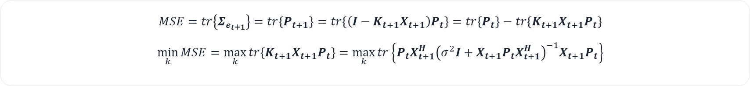
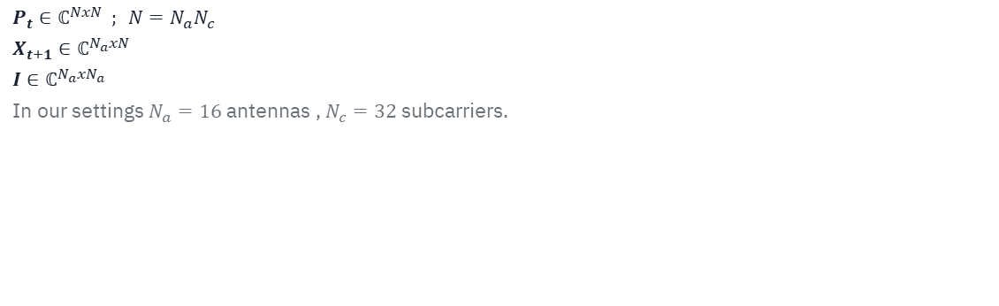
The active greedy policy
At every step, pick the unused subcarrier that maximizes a trace-minimization score:
$$k^{∗}=\arg{\max_{k}{tr\left\{P_{t}X_{t+1}^{H}{\left(σ^{2}I+X_{t+1}P_{t}X_{t+1}^{H}\right)}^{−1}X_{t+1}P_{t}\right\}}}$$
Interpretation
The trace term estimates how much piloting subcarrier k would shrink posterior uncertainty — a one-step-lookahead information-gain score.
$$P_{t}∈ℂ^{NxN} ; N=N_{a}N_{c}$$
$$X_{t+1}∈ℂ^{N_{a}xN}$$
$$I∈ℂ^{N_{a}xN_{a}}$$
In our settings $N_{a}=16$ antennas , $N_{c}=32$ subcarriers.
The one assumption it needs
The true covariance Σ must be known exactly — P, and therefore J(k), is only as good as that prior.
$$MSE=tr\left\{Σ_{e_{t+1}}\right\}=tr\left\{P_{t+1}\right\}=tr\left\{\left(I−K_{t+1}X_{t+1}\right)P_{t}\right\}=tr\left\{P_{t}\right\}−tr\left\{K_{t+1}X_{t+1}P_{t}\right\}$$
$$\min_{k}{MSE}=\max_{k}{tr\left\{K_{t+1}X_{t+1}P_{t}\right\}}=\max_{k}{tr\left\{P_{t}X_{t+1}^{H}{\left(σ^{2}I+X_{t+1}P_{t}X_{t+1}^{H}\right)}^{−1}X_{t+1}P_{t}\right\}}$$

Slide 8
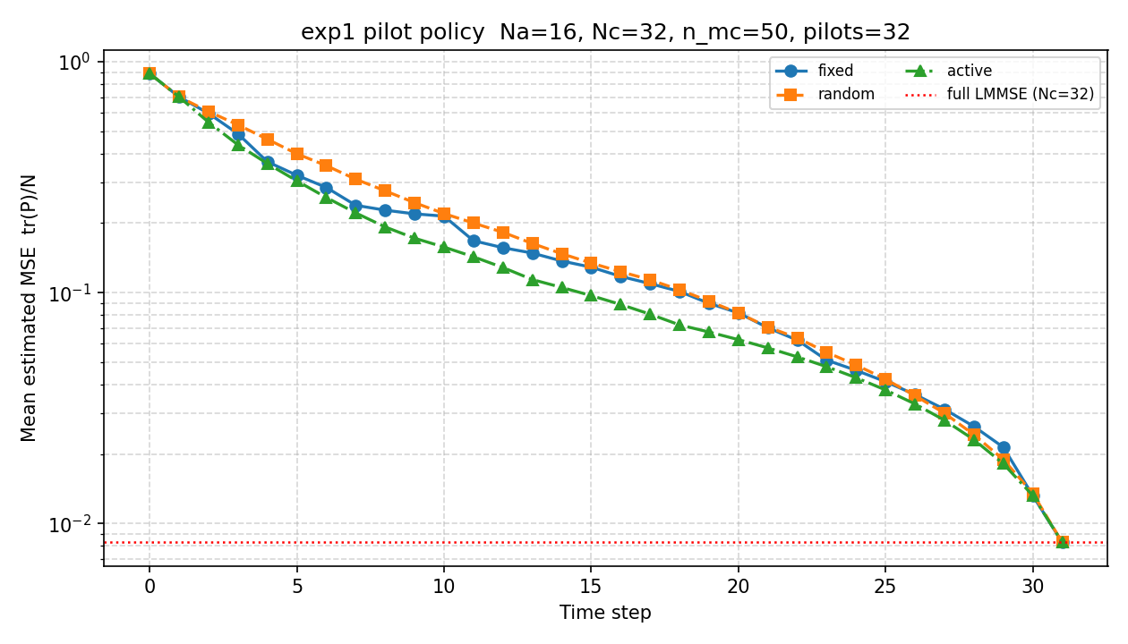
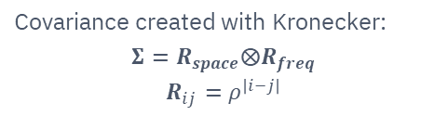
Baseline: active beats fixed, on Gaussian matched prior
Covariance created with Kronecker:
$$Σ=R_{space}⨂R_{freq}$$
$$R_{ij}=ρ^{\left|i−j\right|}$$
This is the best case for the greedy heuristic: the assumed Σ is exactly correct.

Slide 9
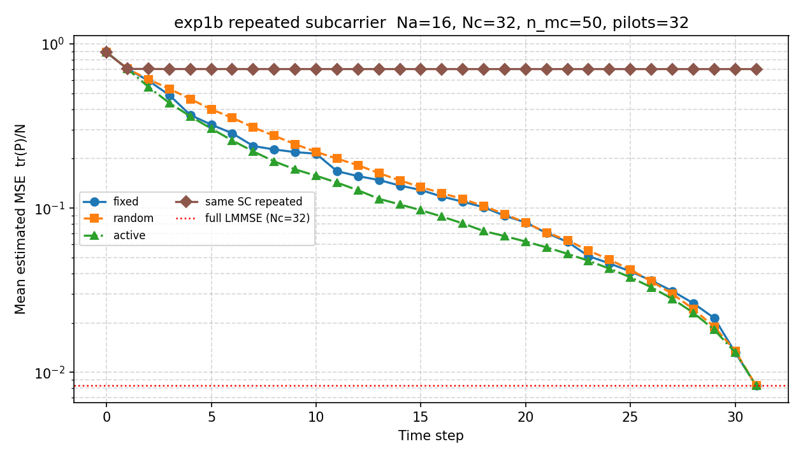
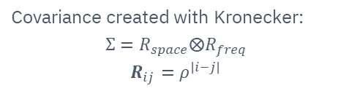
Sampling the same subcarrier repeatedly
Covariance created with Kronecker:
$$Σ=R_{space}⨂R_{freq}$$
$$R_{ij}=ρ^{\left|i−j\right|}$$
Repeating the same subcarrier barely lowers the MSE: 0.704 → 0.702 from 2 to 32 pilots.
Only SC 15's noise averages out (σ²/m); the other subcarriers are learned only via correlation.

Slide 10
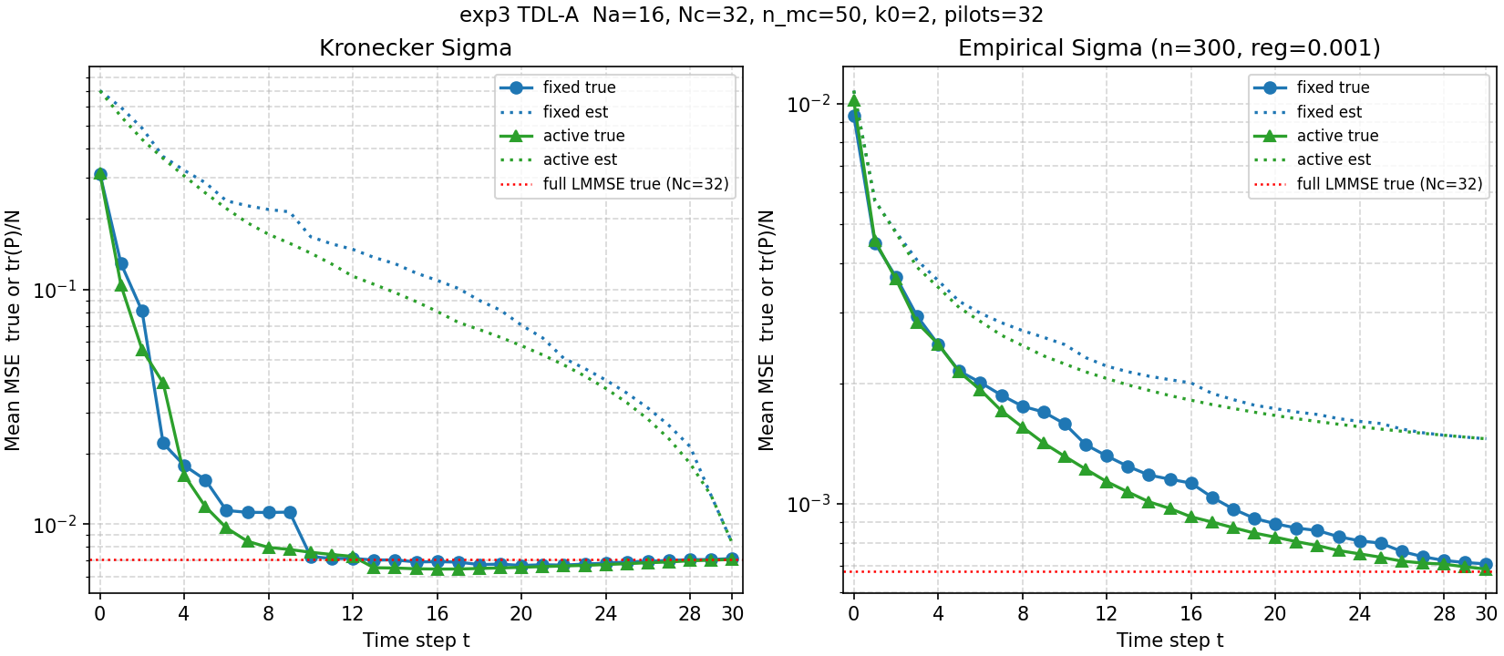
Results on realistic TDL-A channels
SECTION 3 · WHAT THE EXPERIMENTS SHOW
Kronecker prior: active still beats fixed, but a true-vs-estimated gap opens — the model's confidence no longer matches reality.
Empirical prior (fit from TDL-A Monte Carlo draws) closes much of that gap.
Consistent with exp2: replacing a mismatched analytic prior with an empirical covariance estimate partially recovers active's advantage.
Source: new/experiments/exp3_true_vs_estimated_err.py · new/figures/exp1-6/exp3_tdl_err.png

Slide 11
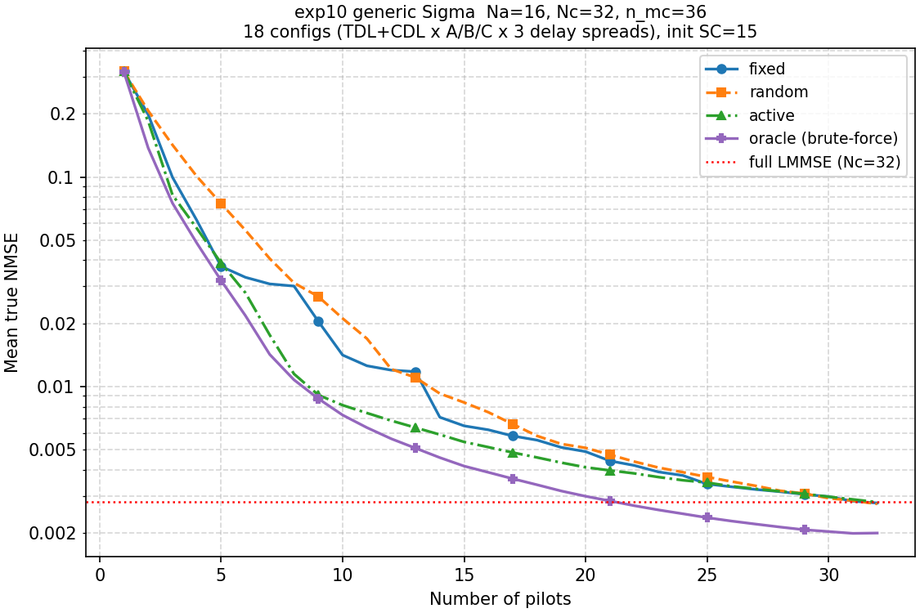

The gap
Main conclusions:
on a matched prior the active selection is better.
The oracle picks based on one lucky-or-unlucky realized noise draw per candidate, while active picks based on noise-independent expected information gain — so the oracle can occasionally get fooled by a lucky draw into picking a less informative subcarrier, while active never can.

Slide 12


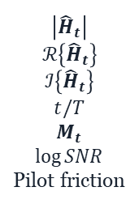

A learned 1-D CNN pilot allocator
SECTION 4 · THE LEGACY CNN APPROACH
CNN that predicts, for every candidate subcarrier, the error that piloting it would leave — then greedily picked the argmin.
$$\log{MSE\left({\hat{h}}_{t+1},h\right)}$$
$$\left|{\hat{H}}_{t}\right|$$
$$ℛ\left\{{\hat{H}}_{t}\right\}$$
$$ℐ\left\{{\hat{H}}_{t}\right\}$$
$$t/T$$
$$M_{t}$$
$$\log{SNR}$$
Pilot friction
CNN
$$\arg{min}$$
Output
CNN
The most informative subcarrier
1-D CNN along the subcarrier axis
Input
7 × 32
Conv1d
k = 5
Conv1d
k = 5
Conv1d
k = 3
Output
32
GroupNorm + GELU between layers, ending in 1×1 convolutions

Slide 13
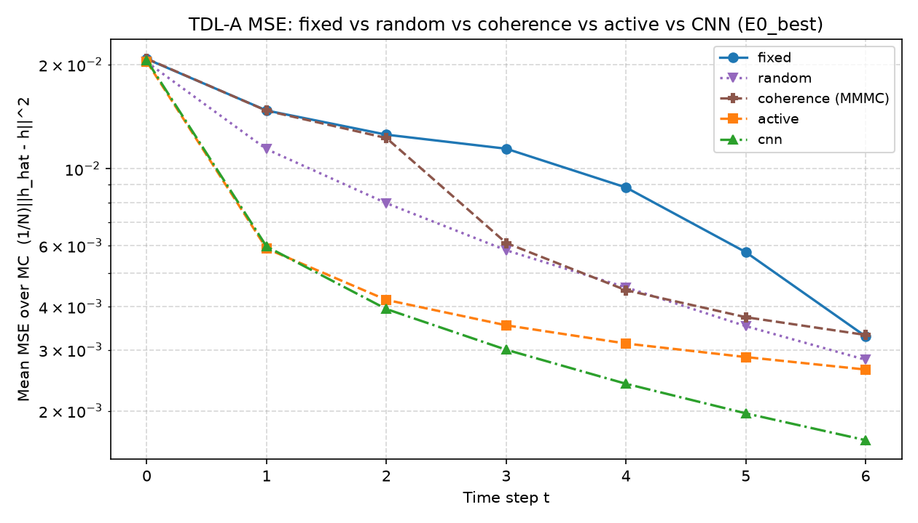
It outperformed every baseline tested
Final-step mean MSE, 250 Monte Carlo TDL-A channels:
Policy | Final MSE | vs. Active
CNN (ours) | 0.00163 | ≈1.6× better
Active | 0.00258 | —
Random | 0.00272 | —
Fixed | 0.00322 | —
Coherence | 0.00327 | —
Source: Final_Presentation - Gilead ans Tal.pptx (legacy old/ framework)

Slide 14

But its gains were never stress-tested
Single scenario: only TDL-A fading tested — no prior-mismatch, non-Gaussian, low-rank or block-cluster stress tests like exp1–9.
Single SNR point — performance at other SNRs is unknown.
This motivates revisiting pilot placement with a method designed for cross-scenario robustness from the start.

Slide 15
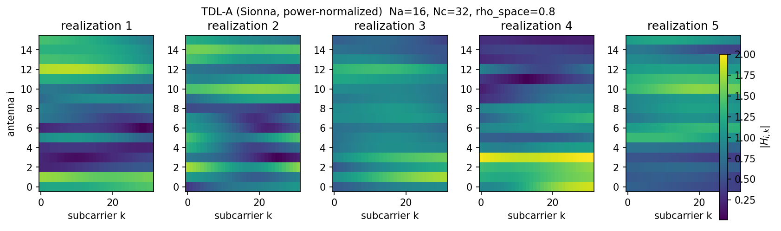
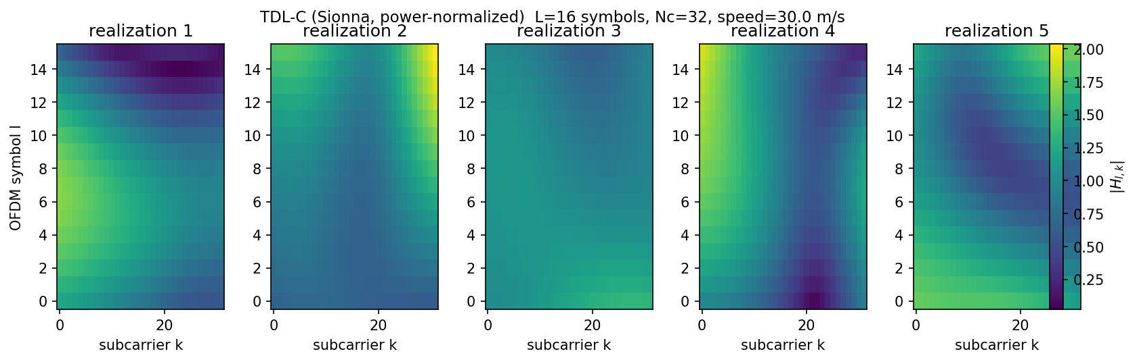
Optional datasets
Space-frequency
Time-frequency

Slide 16
Neither baseline is enough: the active policy needs a prior it can't have, and the CNN was never tested for the robustness this project's own experiments say matters.
SECTION 5 · PROPOSAL
A deep RL agent can optimize the real, long-horizon placement objective end-to-end — without a hand-coded score or a proxy training target.

Slide 17


MDP formulation
Agent
Action
Environment
Reward
policy network
pick an unused subcarrier (masked)
measures & updates state
Δ true NMSE (training only)
State — built only from Σ-free quantities
Deliberately excluded
Pilots-used mask
|ĥ| magnitude (Σ-free estimate)
A model-free measurement residual
SNR · pilots-used fraction
J(k) and the posterior block-trace both require an assumed Σ — exactly what deployment doesn't have. Getting ĥ and the residual from a Σ-free estimator (not today's LMMSE posterior) is an open implementation question.

Slide 18
Open research questions
Training data: which channels?
Key properties to have:
Structure to learn.
Smoothness.
Important to remember: If every subcarrier is equally informative, the active-vs-fixed gap vanishes and there is nothing to learn from.
Prior free design: how to update a wrong initial prior?
The agents indirectly learns the prior – how to change the covariance along the way?
Model-based solutions.

Slide 19



Training design
Scenario registry
Simulator (new/)
Rollout buffer
Policy update
versioned, checked-in config
live environment, not a fixed log
cached episodes, for sweeps & reuse
MaskablePPO
Repeats across sweeps — the same versioned scenario spec feeds every run, so results are comparable.
Online rollouts against the live simulator — the agent is never capped by a logged heuristic's coverage.
Exact mismatched-prior parameterization is explicitly deferred to a later pass.

Slide 20


Algorithm & infrastructure
MaskablePPO
ClearML
sb3-contrib
experiment tracking
The action space shrinks every step — pick an unused subcarrier. MaskablePPO handles that natively, instead of hand-rolling action masking on top of a custom policy gradient.
Tracks metrics and configs across scenario sweeps, versions cached rollouts, and orchestrates hyperparameter sweeps — the reproducibility layer this repo doesn't have yet.

Slide 21
Evaluation plan
The trained policy wraps the existing PilotPolicy protocol, dropping directly into run_until_threshold for an apples-to-apples comparison across every exp1–9 scenario family.
Fixed
Active
Legacy CNN
RL agent
Oracle
uniform, blind
greedy, needs known Σ
one scenario only
to be measured
upper bound (slide 10)
Increasing information used, left to right — the open question is how close the RL agent lands to the oracle without ever seeing Σ.

Slide 22
Thank you.
Questions?
Notes:
Happy to go deeper on any of the open questions: the mismatched-prior parameterization, the sigma-free observation design, or the channel screening procedure.

